Slide 1




Understanding relationships between Hospital, Population size and Outcomes : Mortality and Patient Experience in US counties
Rabia Otry, Vilma Santos,
Rohan Mohindroo, Angang Li
2018-06-09

Slide 2




Introduction
United States has focused on decreasing health care costs. US spending is the most expensive in the world, with costs projected to rise through 2020.
Data showed that in 2013, US spent approximately 17% of its gross domestic product (GDP) on health care, which is significantly higher than health care spending in other countries.
Despite high health care spending, the US shows poorer results for certain health care outcomes compared with other countries e.g. lower life expectancy
Resources: https://www.gnyha.org/wp-content/uploads/2017/09/SocialDeterminants_digital-1.pdf

Slide 3

Introduction
The Affordable Care Act (ACA) enacted and signed into law in 2010, has made many changes to reimbursements in healthcare. One involved linking part of hospital pay to Patient Experience / Customer Satisfaction scores.
In 2012, Centers of Medicare and Medicaid Services, the largest single payor for healthcare, has started to modify payments based on quality performance/outcomes.
This included how hospitals score on Hospital Consumer Assessment of Healthcare Providers and Systems (HCAHPS), first national, standardized, publicly-reported survey of patients' perspectives of hospital care.

Slide 4

Introduction
The pressure on hospital finances has driven some hospitals to close or consolidate and streamline to improve on overall performance.
With hospitals capability to directly impact outcomes in their service areas, it is equally critical to understand impact of their presence on Mortality Rate.
The objective of our study is to explore relationships between Patient Experience rating, Mortality Rate, and Number of Hospitals by County.
Scope & Limitations:
Findings will be presented for counties in the US and for year 2016 only.
Hospital bed count per county not factored into the analysis.

Slide 5
Motivations & Data Cleanup

Slide 6
How do patient experience rating and mortality rate relate to population size and number of survey response?
Is there a direct relationship between Number of Hospitals and Population Size?
Does Number of Hospitals serving the population affect Hospital Patient Experience?
Does Population Size affect Hospital Patient Experience?
Does Number of Survey Responses affect Hospital Patient Experience?
Does Number of Hospitals serving the population affect Mortality Rate?
Does Population Size affect Mortality Rate?
Does Number of Hospitals affect Mortality Rate?

Slide 7
Methods: Data Sources
HCAPHS data, queried by hospital name from Data.gov
Over 4,000 hospitals nationwide with patient experience ratings
Mortality data
Nationwide by county from the CDC
FIPS data
Nationwide county data by FIPS code from the Census Bureau
Land area data
To normalize population by county

Slide 8
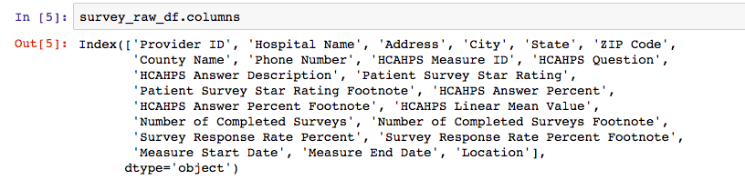
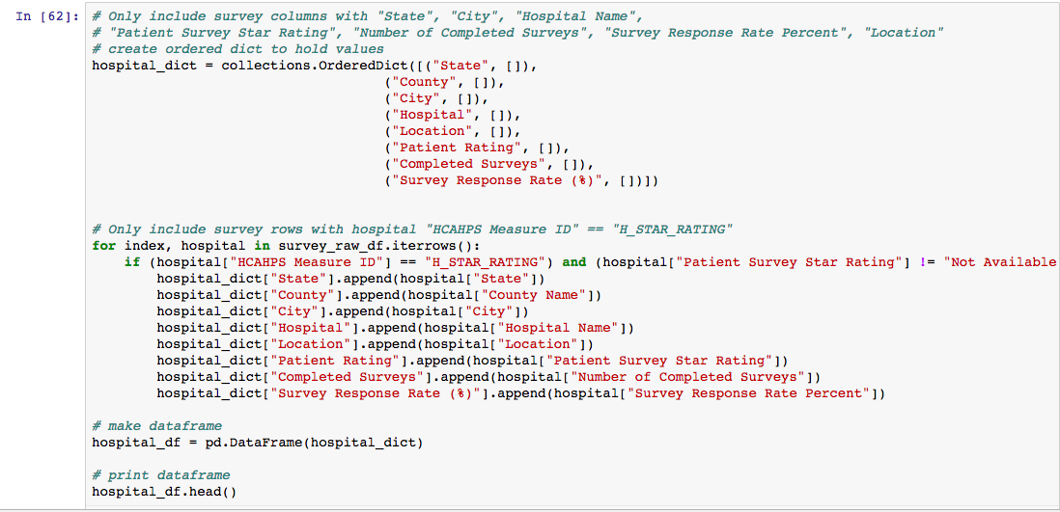
Data exploration and cleanup: Patient Experience Survey

Slide 9
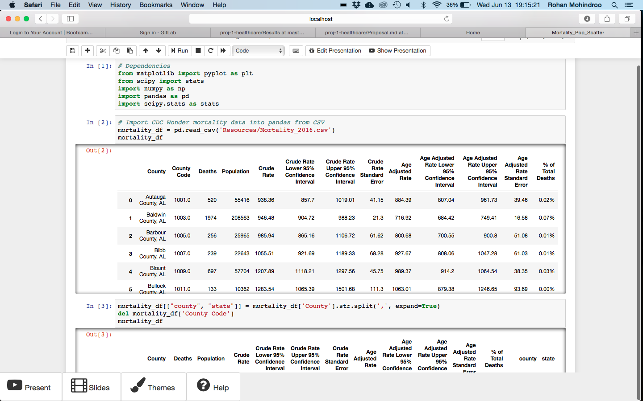
Data exploration and cleanup: Mortality Data

Slide 10
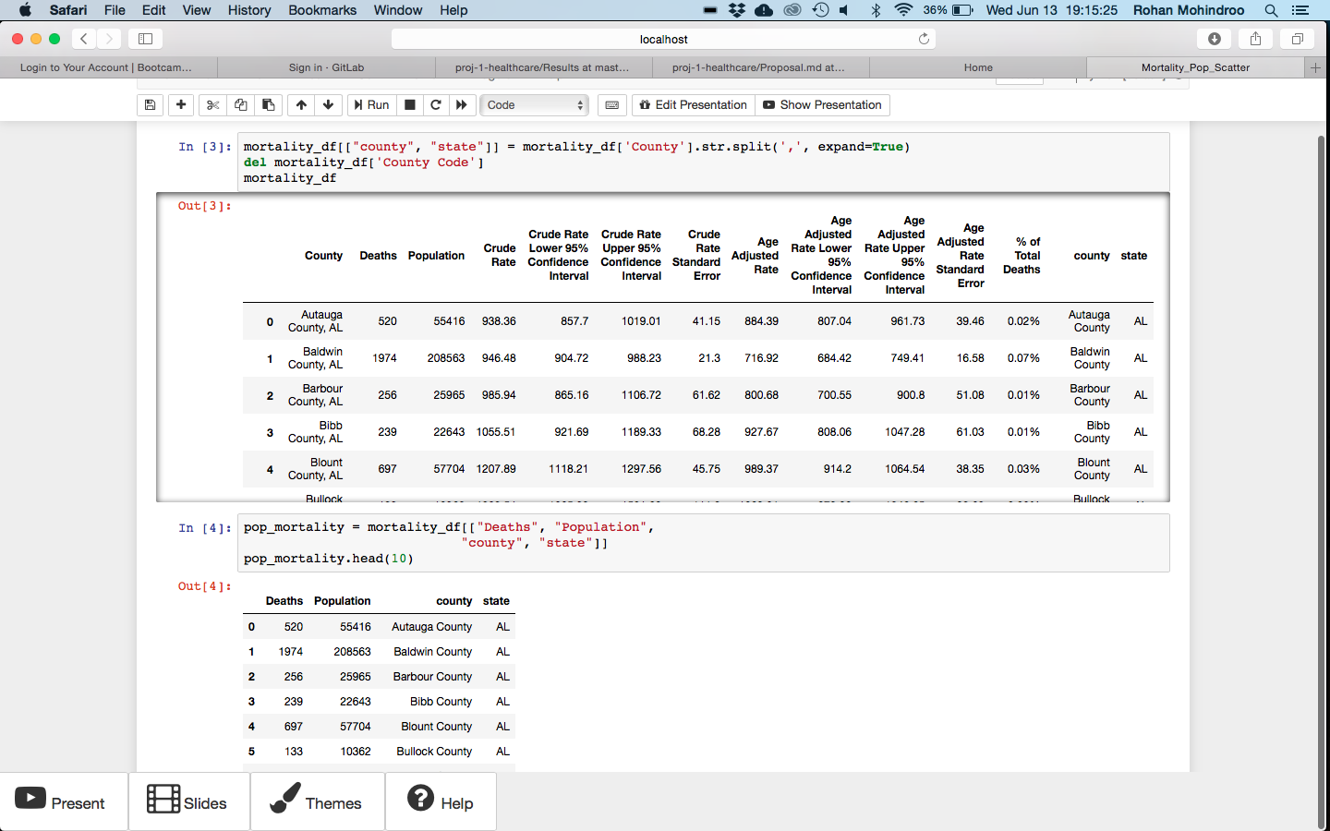
Data exploration and cleanup: Mortality Data

Slide 11
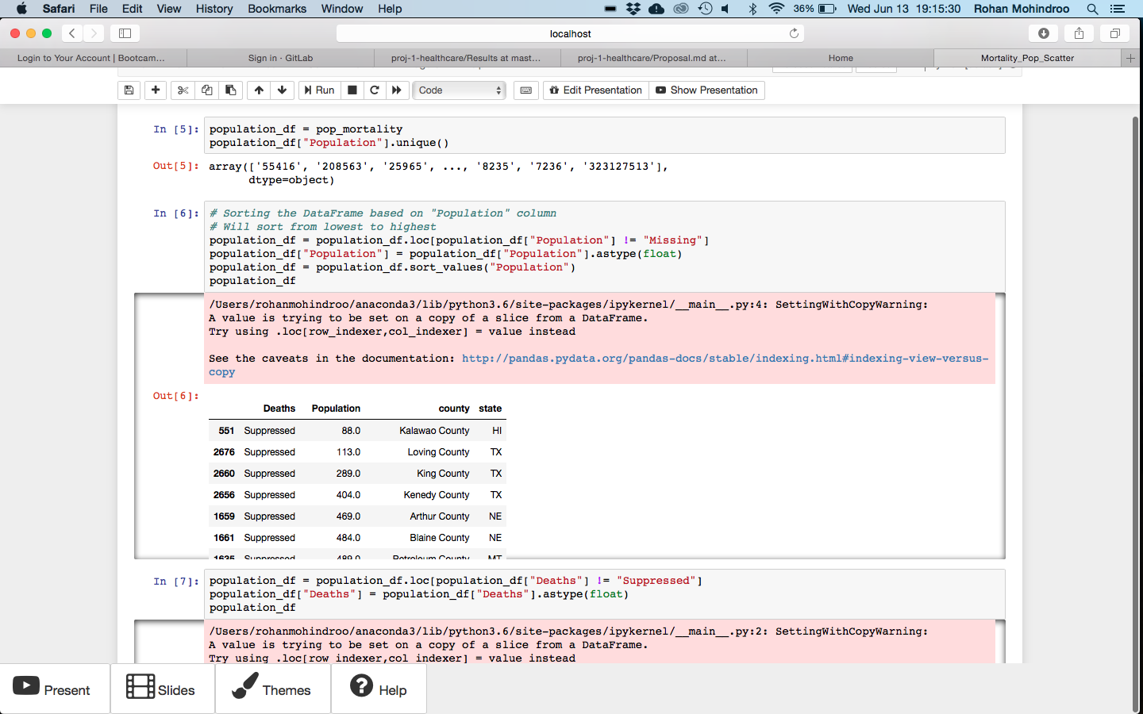
Data exploration and cleanup: Mortality Data

Slide 12
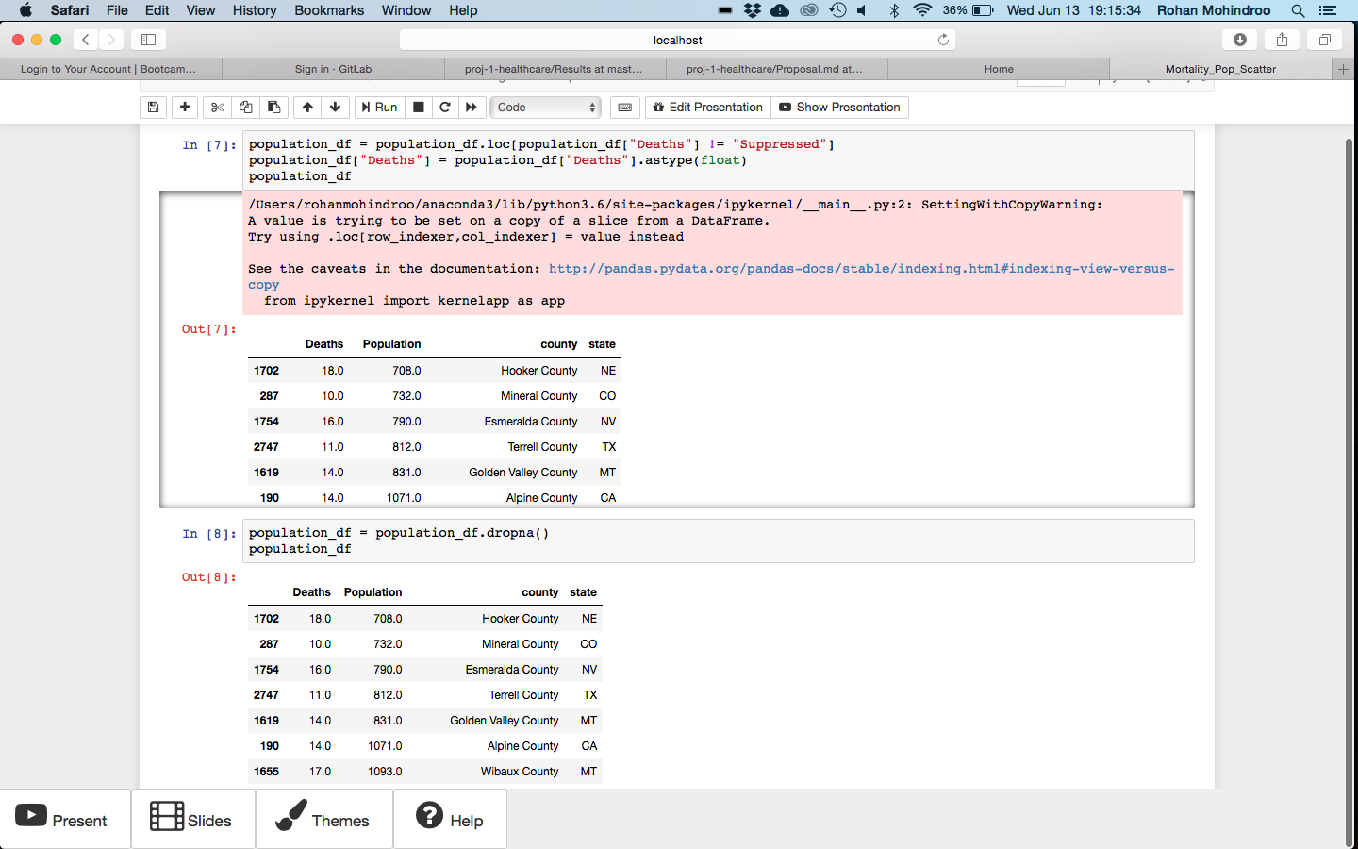
Data exploration and cleanup: Mortality Data

Slide 13
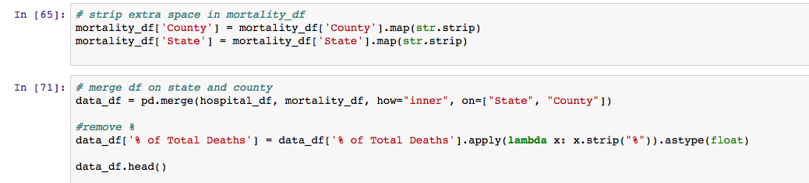
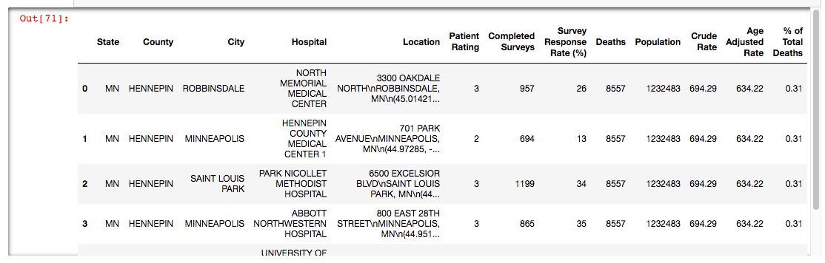
Data exploration and cleanup: Mortality Data

Slide 14
Data exploration: FIPS & Mapping
sample size
Survey, population, and mortality
State | County | # of Hospitals | # of Completed Surveys | Population | Deaths | …
AL | Autauga | 1 | 579 | 55416 | 520 | …
AL | Baldwin | 3 | 2274 | 208563 | 1974 | …
Spatial patterns?

Slide 15
Data exploration: FIPS & Mapping
Survey, population, and mortality
State | County | # of Hospitals | # of Completed Surveys | Population | Deaths | …
AL | Autauga | 1 | 579 | 55416 | 520 | …
AL | Baldwin | 3 | 2274 | 208563 | 1974 | …
Spatial patterns?
Library and API: Plotly
Data: FIPS (Federal Information Processing Standards)

Slide 16
Relational join
Survey, population, and mortality
State | County | # of Hospitals | # of Completed Surveys | Population | Deaths | …
AL | Autauga | 1 | 579 | 55416 | 520 | …
AL | Baldwin | 3 | 2274 | 208563 | 1974 | …
FIPS code
FIPS | State | County
01001 | AL | Autauga
01003 | AL | Baldwin
Data source: United States Census Bureau, 2016

Slide 17
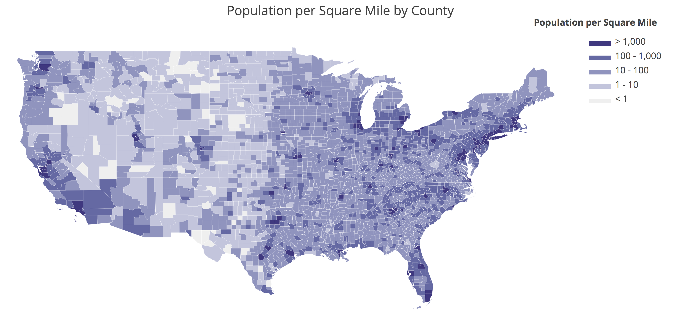
Population by county

Slide 18

Number of completed surveys
aka. sample size

Slide 19
Results

Slide 20
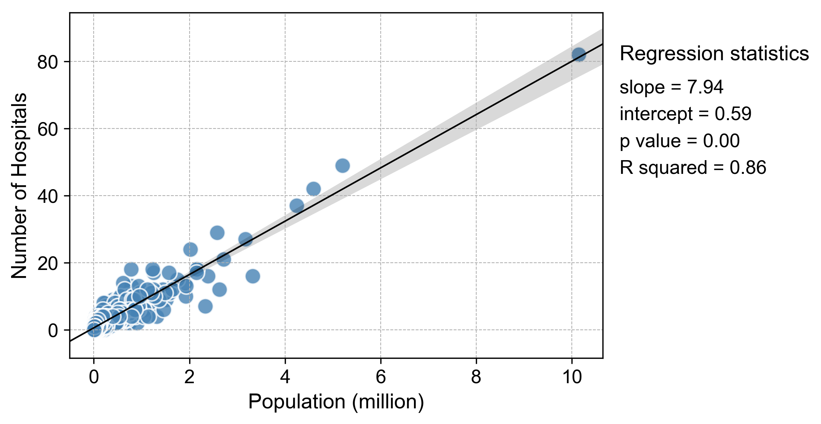
1) Is there a direct relationship between Number of Hospitals and Population Size?

Slide 21
Does Number of Hospitals serving the population affect Hospital Patient Experience?
Does Population Size affect Hospital Patient Experience?
Does Number of Survey Responses affect Hospital Patient Experience?

Slide 22
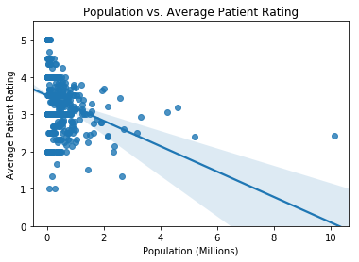
2a) Does Population Size affect Hospital Patient Experience?
p = 1.66e-18

Slide 23
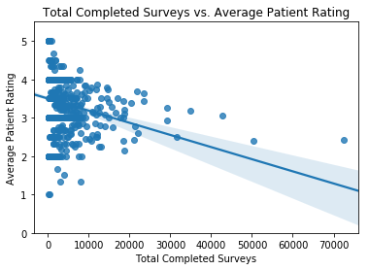
2b) Does Number of Survey Responses affect Hospital Patient Experience?
p = 1.86e-13

Slide 24
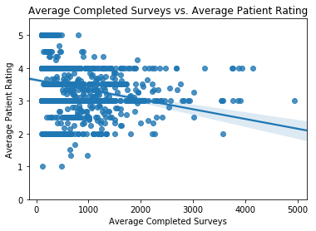
2b) Does Number of Survey Responses affect Hospital Patient Experience?
p = 6.63e-25

Slide 25
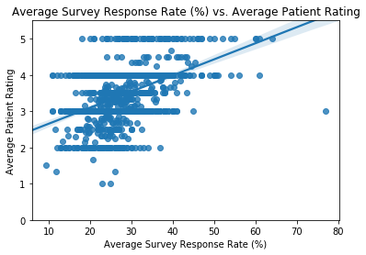
2b) Does Number of Survey Responses affect Hospital Patient Experience?
p = 5.16e-80

Slide 26
Does Number of Hospitals serving the population affect Mortality Rate?
Does Population Size affect Mortality Rate?
Does Number of Hospitals affect Mortality Rate?

Slide 27
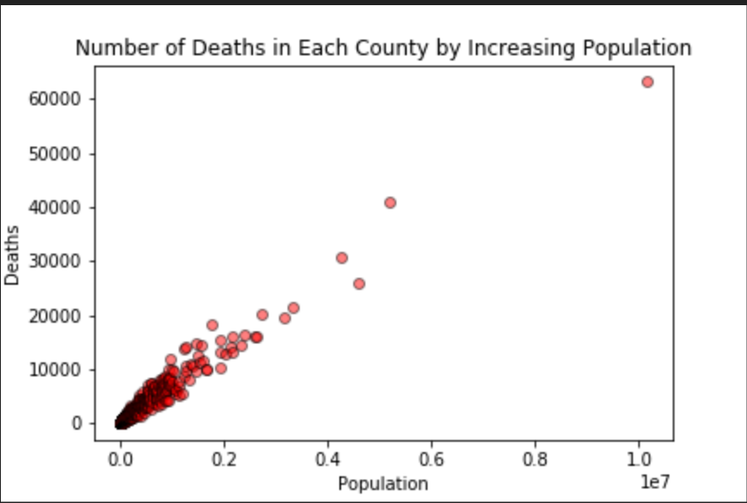
3a) Does Population Size affect Mortality Rate?
p = 0.0

Slide 28
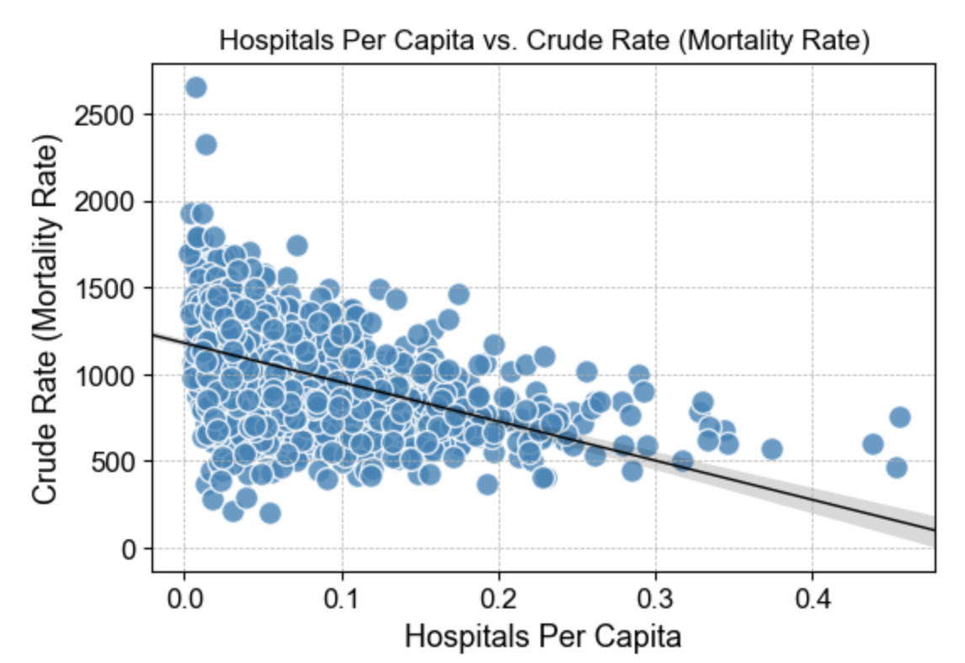
3b) Does Number of Hospitals affect Mortality Rate?
Slope = -2254
Intercept = 1178
Rvalue = -0.49
p = 3.56e-102

Slide 29
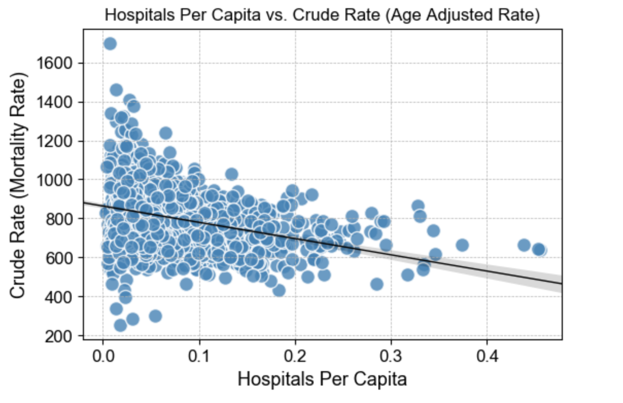
3b) Does Number of Hospitals affect Mortality Rate?
Slope = -834
Intercept = 863
Rvalue = -0.33
p = 2.0e-42

Slide 30
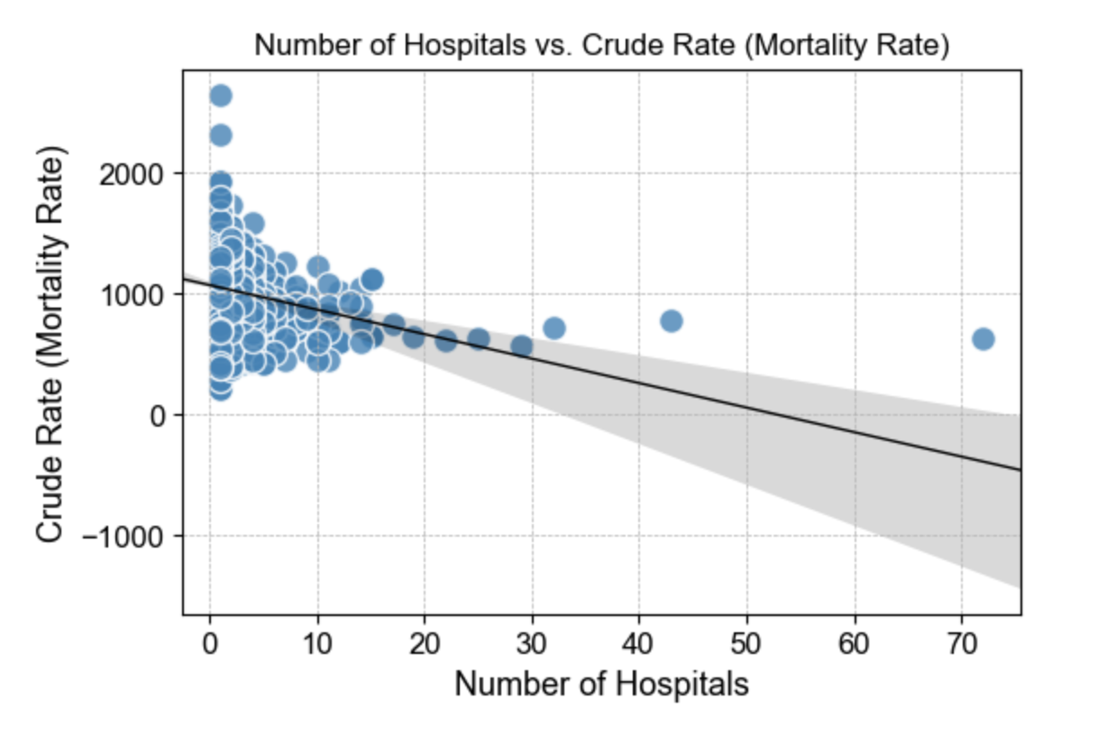
3b) Does Number of Hospitals affect Mortality Rate?
Slope = -20
Intercept = 1070
Rvalue = -0.24
p = 2.0e-22

Slide 31
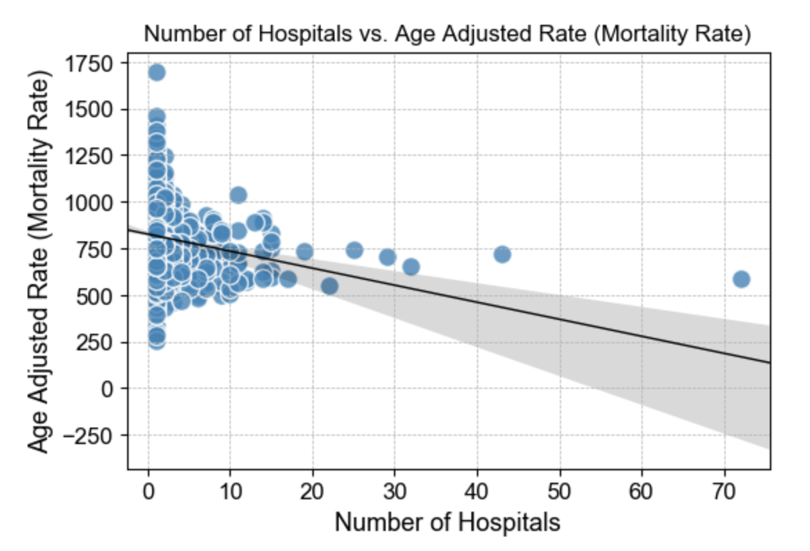
3b) Does Number of Hospitals affect Mortality Rate?
Slope = -9
Intercept = 826
Rvalue = -0.19
p = 6.6e-15

Slide 32
Conclusions

Slide 33
How do patient experience rating and mortality rate relate to population size and number of survey response?
Is there a direct relationship between Number of Hospitals and Population Size?
Does Number of Hospitals serving the population affect Hospital Patient Experience?
Does Population Size affect Hospital Patient Experience?
Does Number of Survey Responses affect Hospital Patient Experience?
Does Number of Hospitals serving the population affect Mortality Rate?
Does Population Size affect Mortality Rate?
Does Number of Hospitals affect Mortality Rate?

Slide 34
(1) The survey data are more reliable (larger sample size) for places with larger population; (2) The number of hospital increases with population size.
Is there a direct relationship between Number of Hospitals and Population Size?

Slide 35
Yes. As population increased, patient experience ratings decreased (2a). As the total of completed surveys increased, patient experience ratings decreased; and as average completed surveys increased, patient experience ratings decreased (2b). Additionally, as survey response rates increased, ratings increased.
Does Number of Hospitals serving the population affect Hospital Patient Experience?
Does Population Size affect Hospital Patient Experience?
Does Number of Survey Responses affect Hospital Patient Experience?

Slide 36
Yes. Data showed that as population increases, deaths increase. Data showed that as Hospital per Capita (# of hospitals per population) and Number of Hospitals in a County increased, Mortality Rates (Crude Rate & Age Adjusted Rate) decreased. Further investigation is needed, for example, on hospitals by bed size to understand if overcapacity is a factor.
Does Number of Hospitals serving the population affect Mortality Rate?
Does Population Size affect Mortality Rate?
Does Number of Hospitals affect Mortality Rate?

Slide 37
Questions?

